Slide 1
JavaScript - UFO hunter game Game Plan

Slide 2
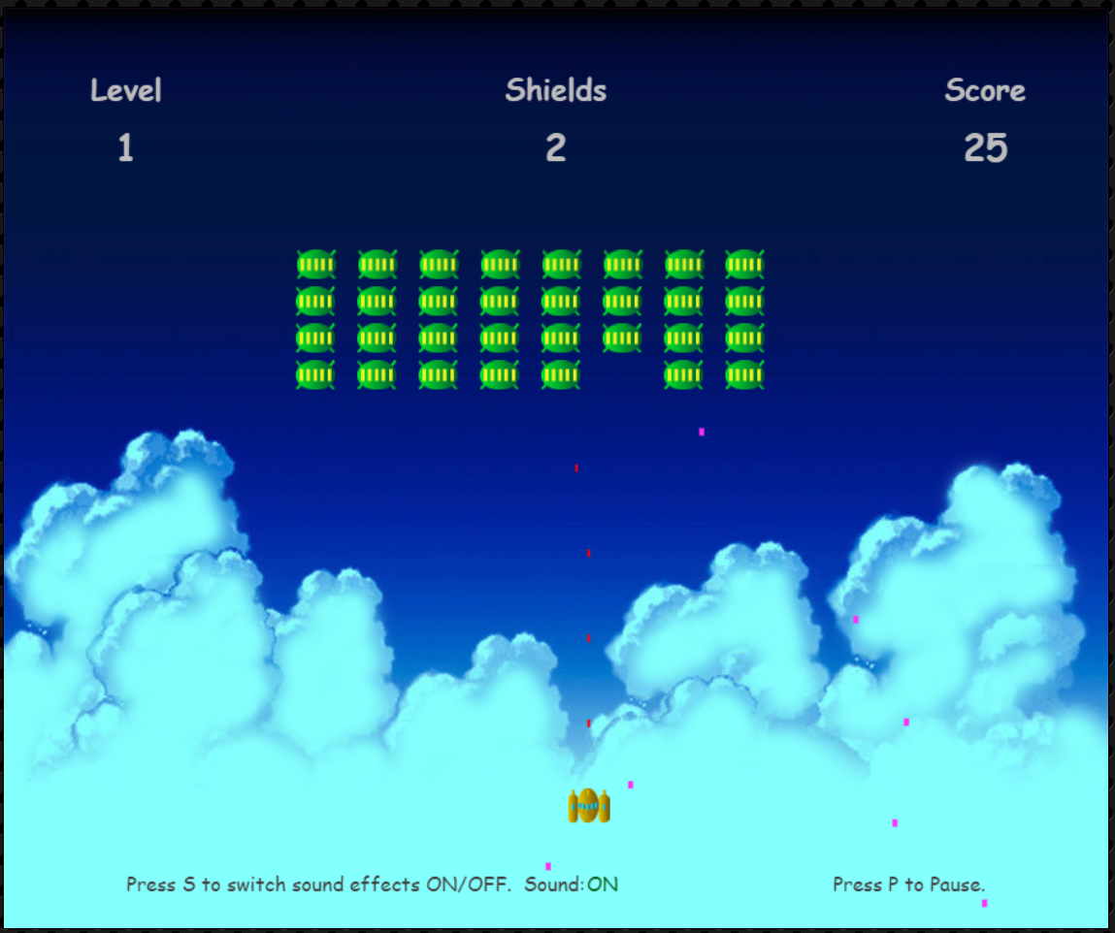
Game plan
Realized game

